Slide 1
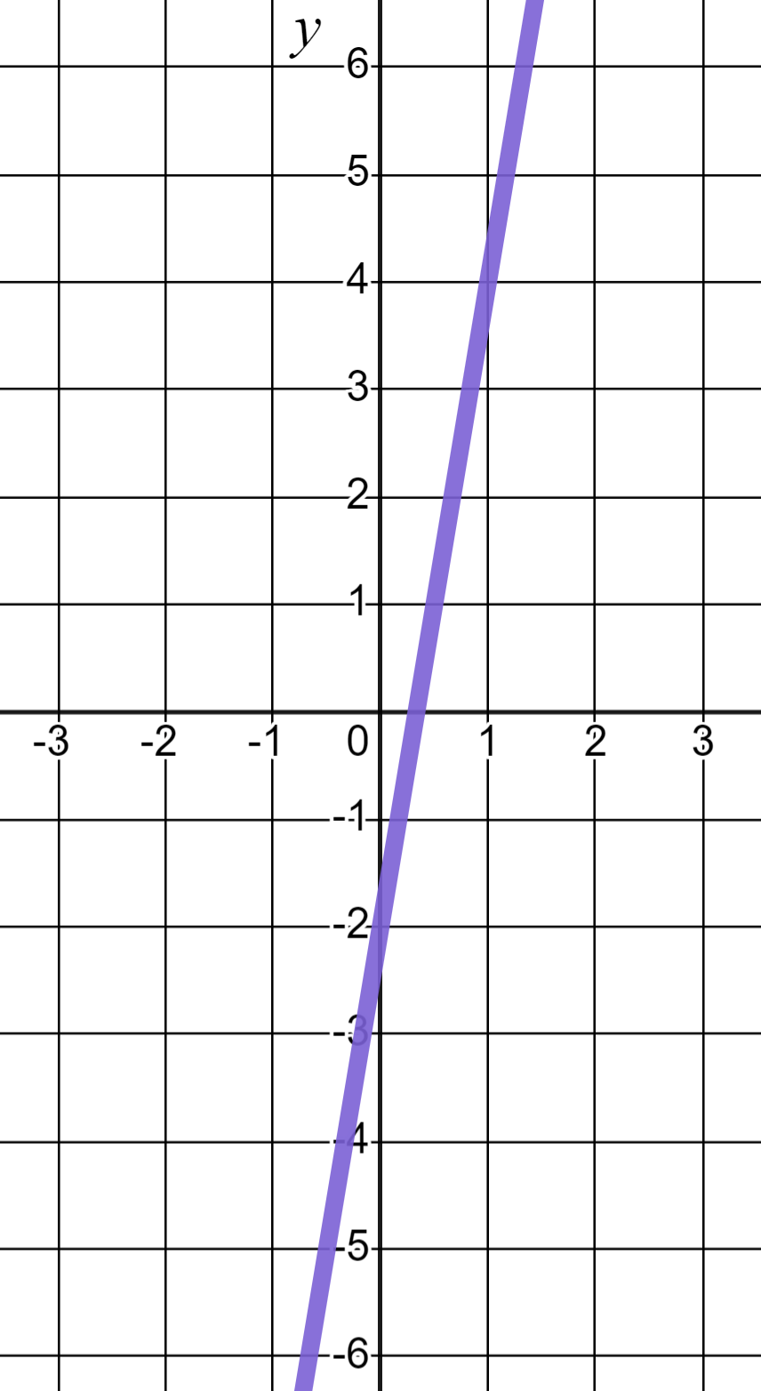
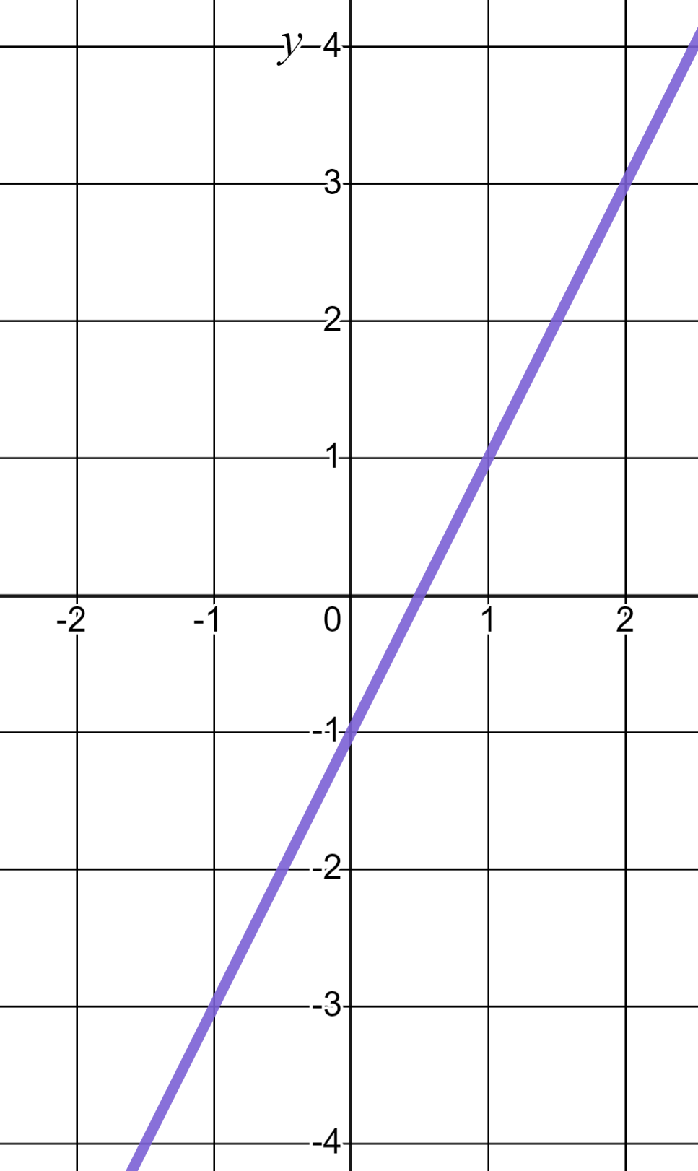
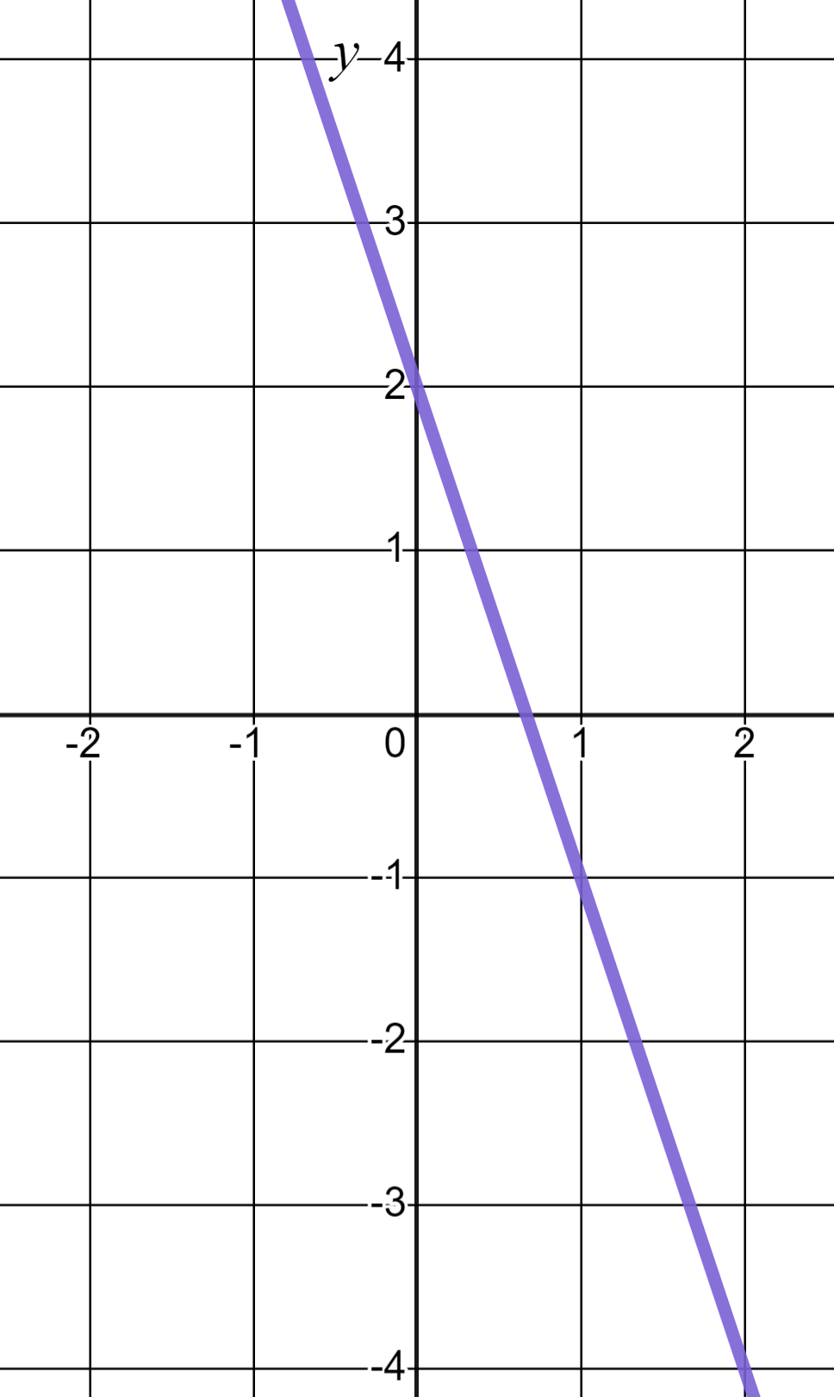
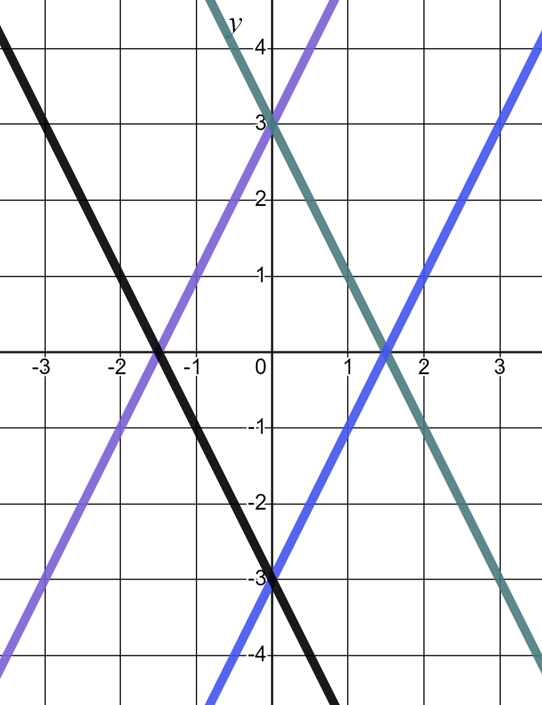
Equations and their graphs
Task A: Reviewing features of linear graphs
1) Gradient of 6 and a y-intercept of (0, −2) is a description unique to graph (a). Write descriptions for b) and c)
a)
b)
c)
b) Gradient of 2 and a y-intercept of (0, −1)
c) Gradient of −3 and a y-intercept of (0, 2)
2) Match the linear equations to their respective lines.
a) y = 2x + 3
c) y = −3 − 2x
d) y = 2x − 3
b) y = 3 − 2x
c) y = −3 − 2x
d) y = 2x − 3
a) y = 2x + 3
b) y = 3 − 2x

Slide 2
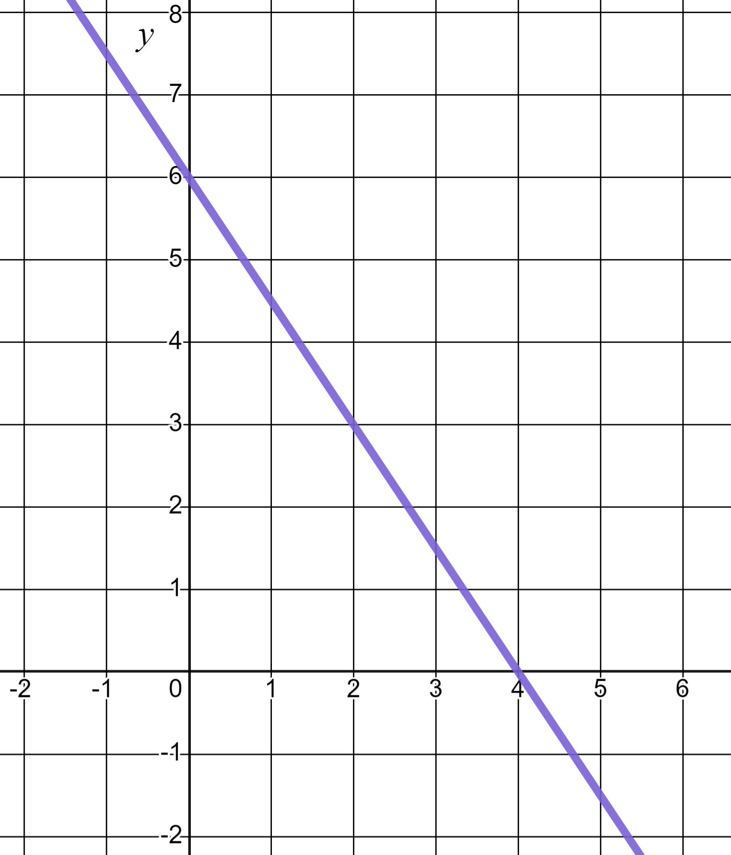
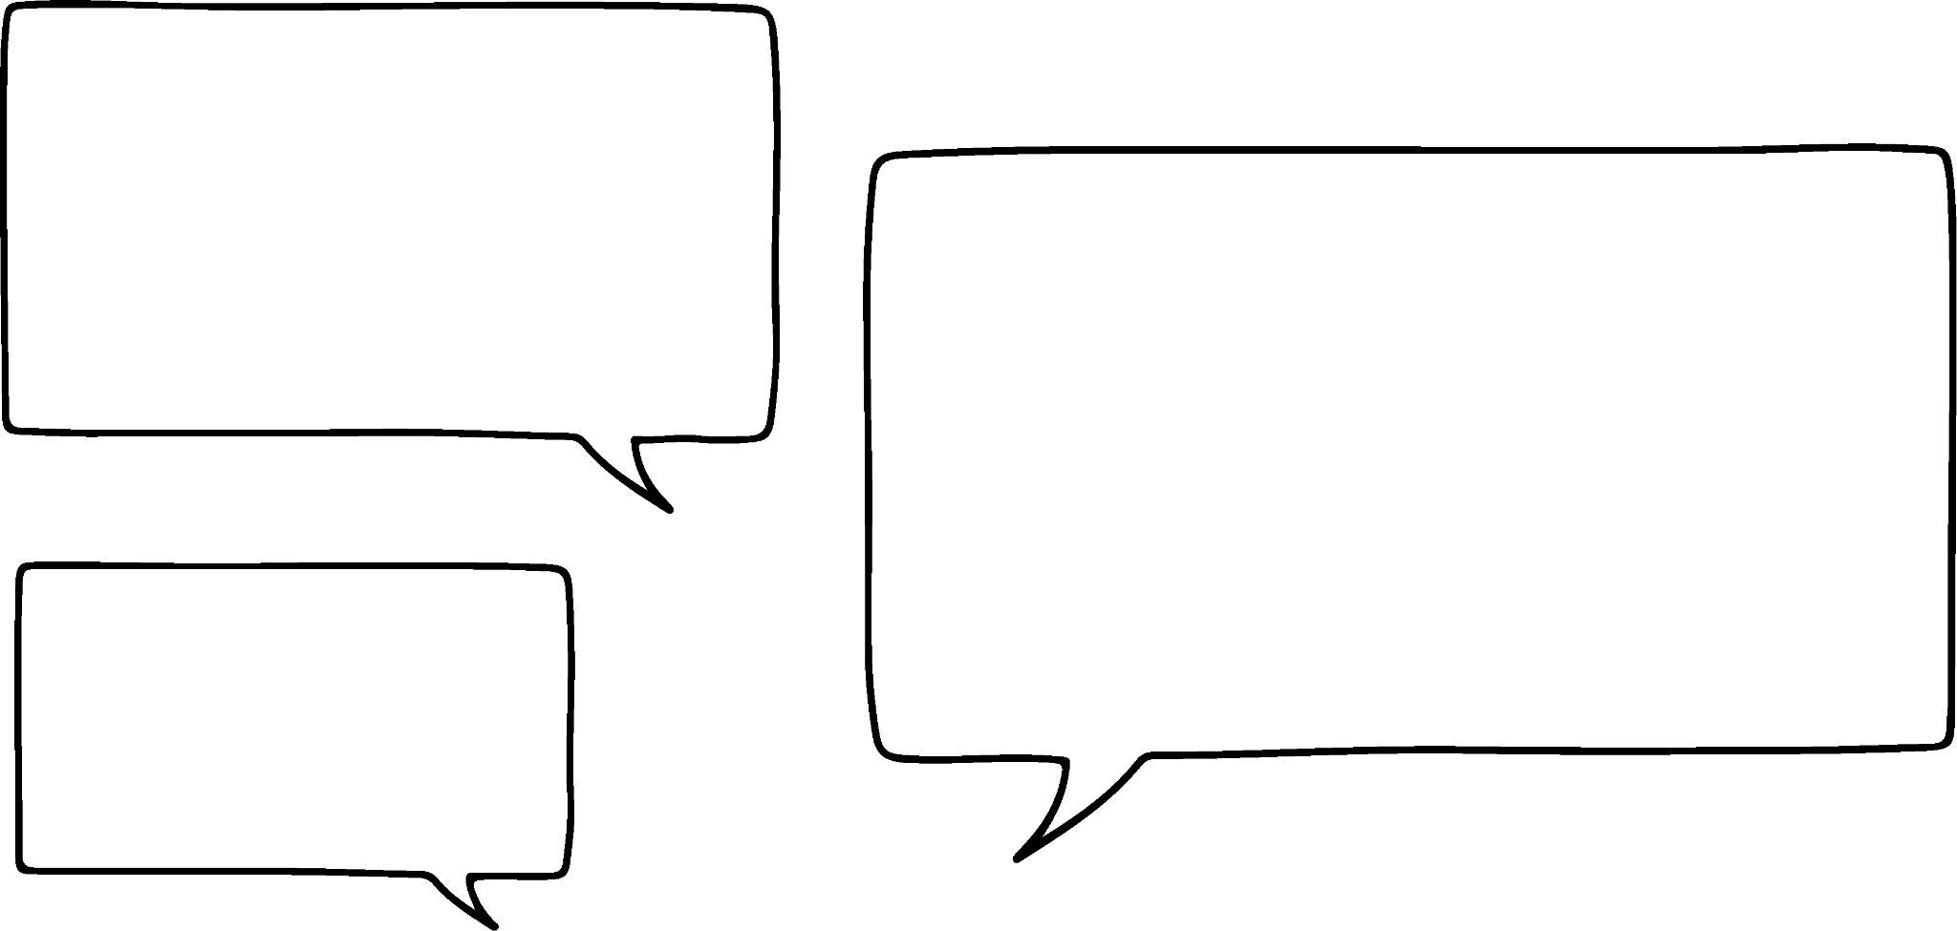
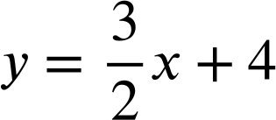

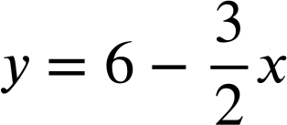
Equations and their graphs
3) Laura is writing the equation of this linear graph.
2
I see a change of 3 in y and a change of 2 in x and and intercept of 4 so this is the line
3
✖
Write at least two sentences to explain Laura’s errors to her. You may choose to annotate the graph in your explanation.
The gradient is the change in y divided by the change in x but with respect to the positive x-direction.
In the form y = mx + c the c relates to the y-intercept, not that of the x axis.
This is the line

Slide 3
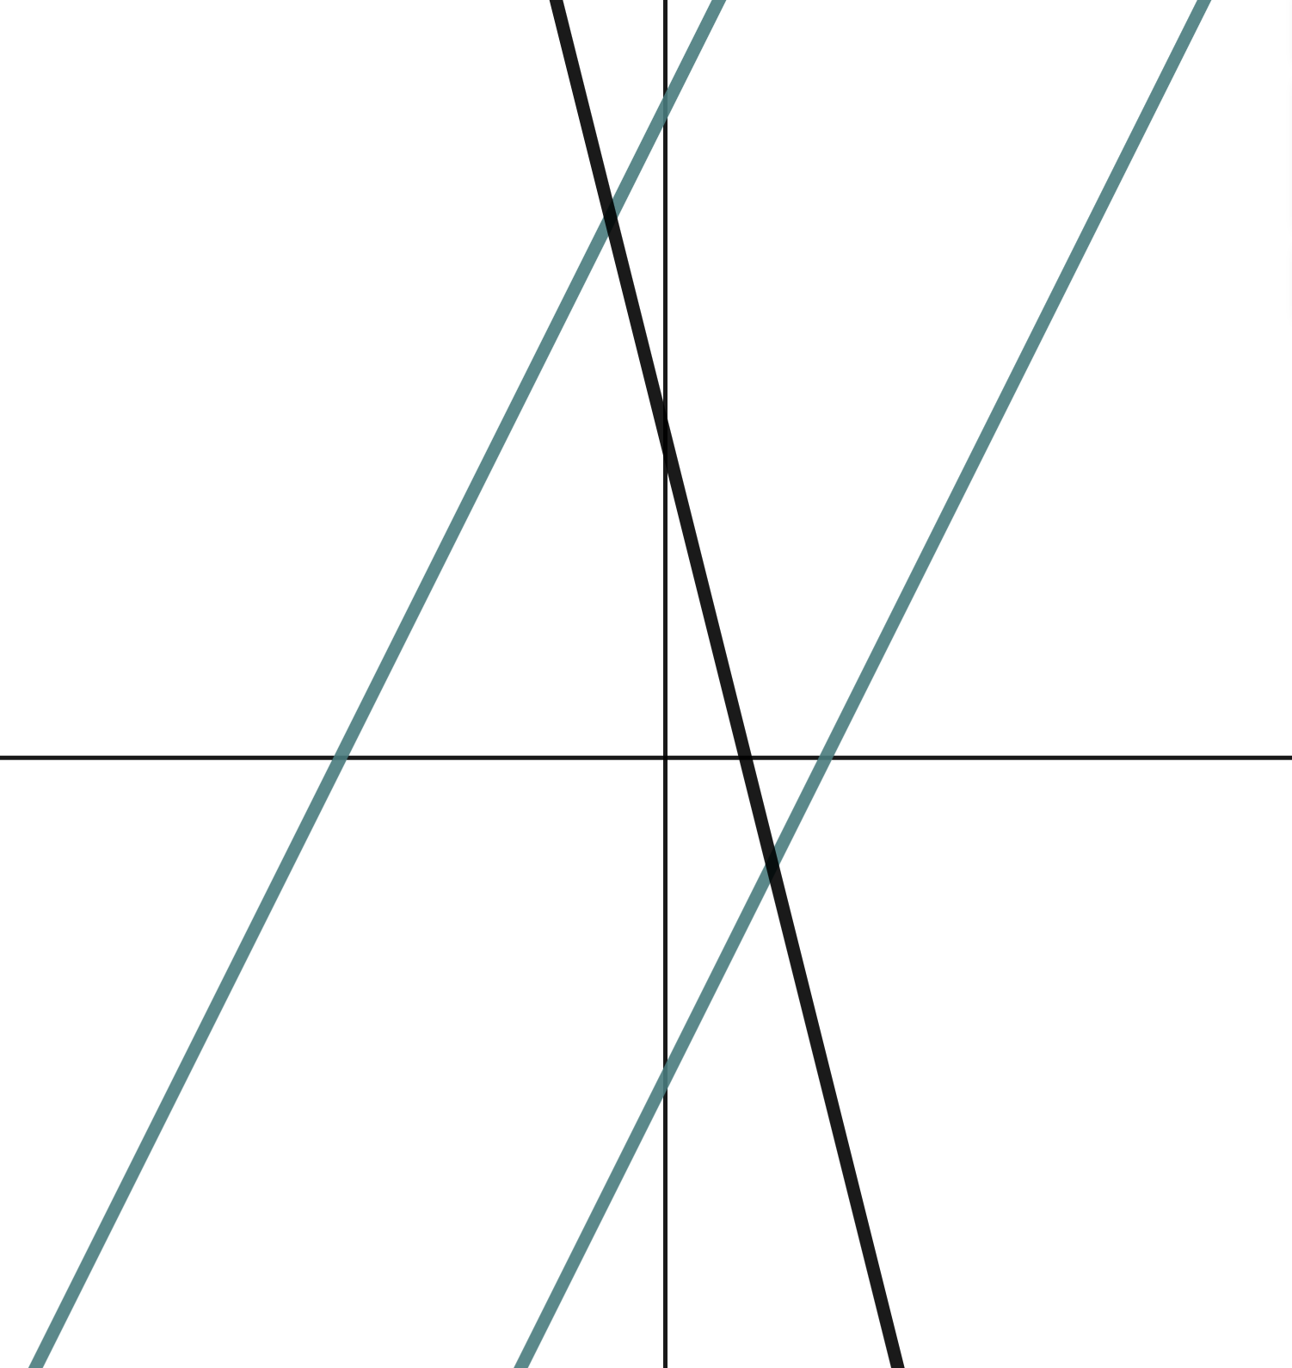
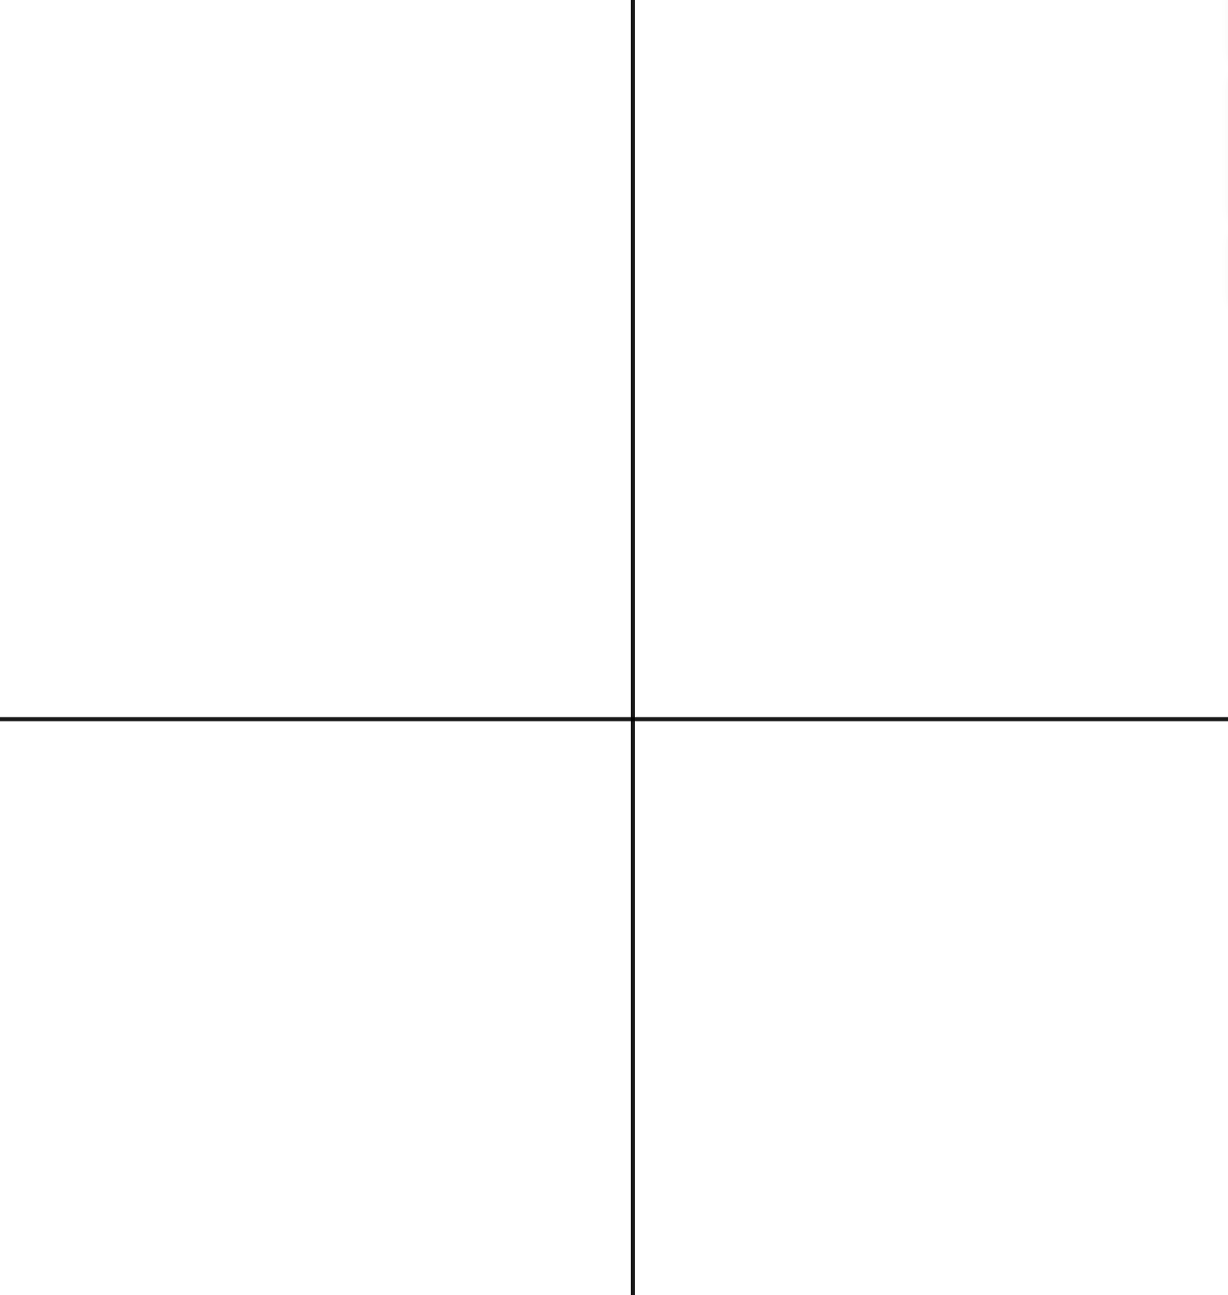
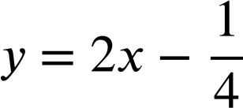
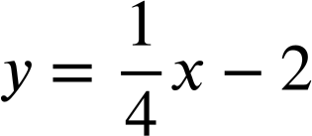
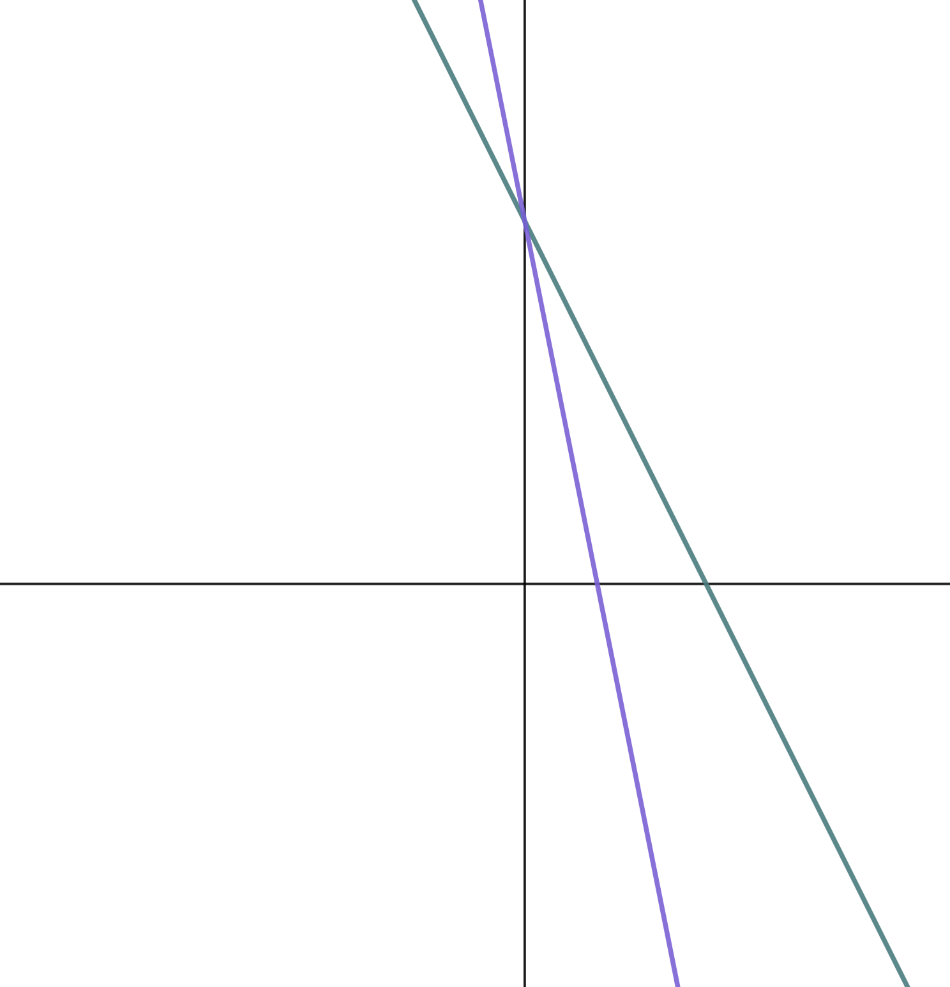
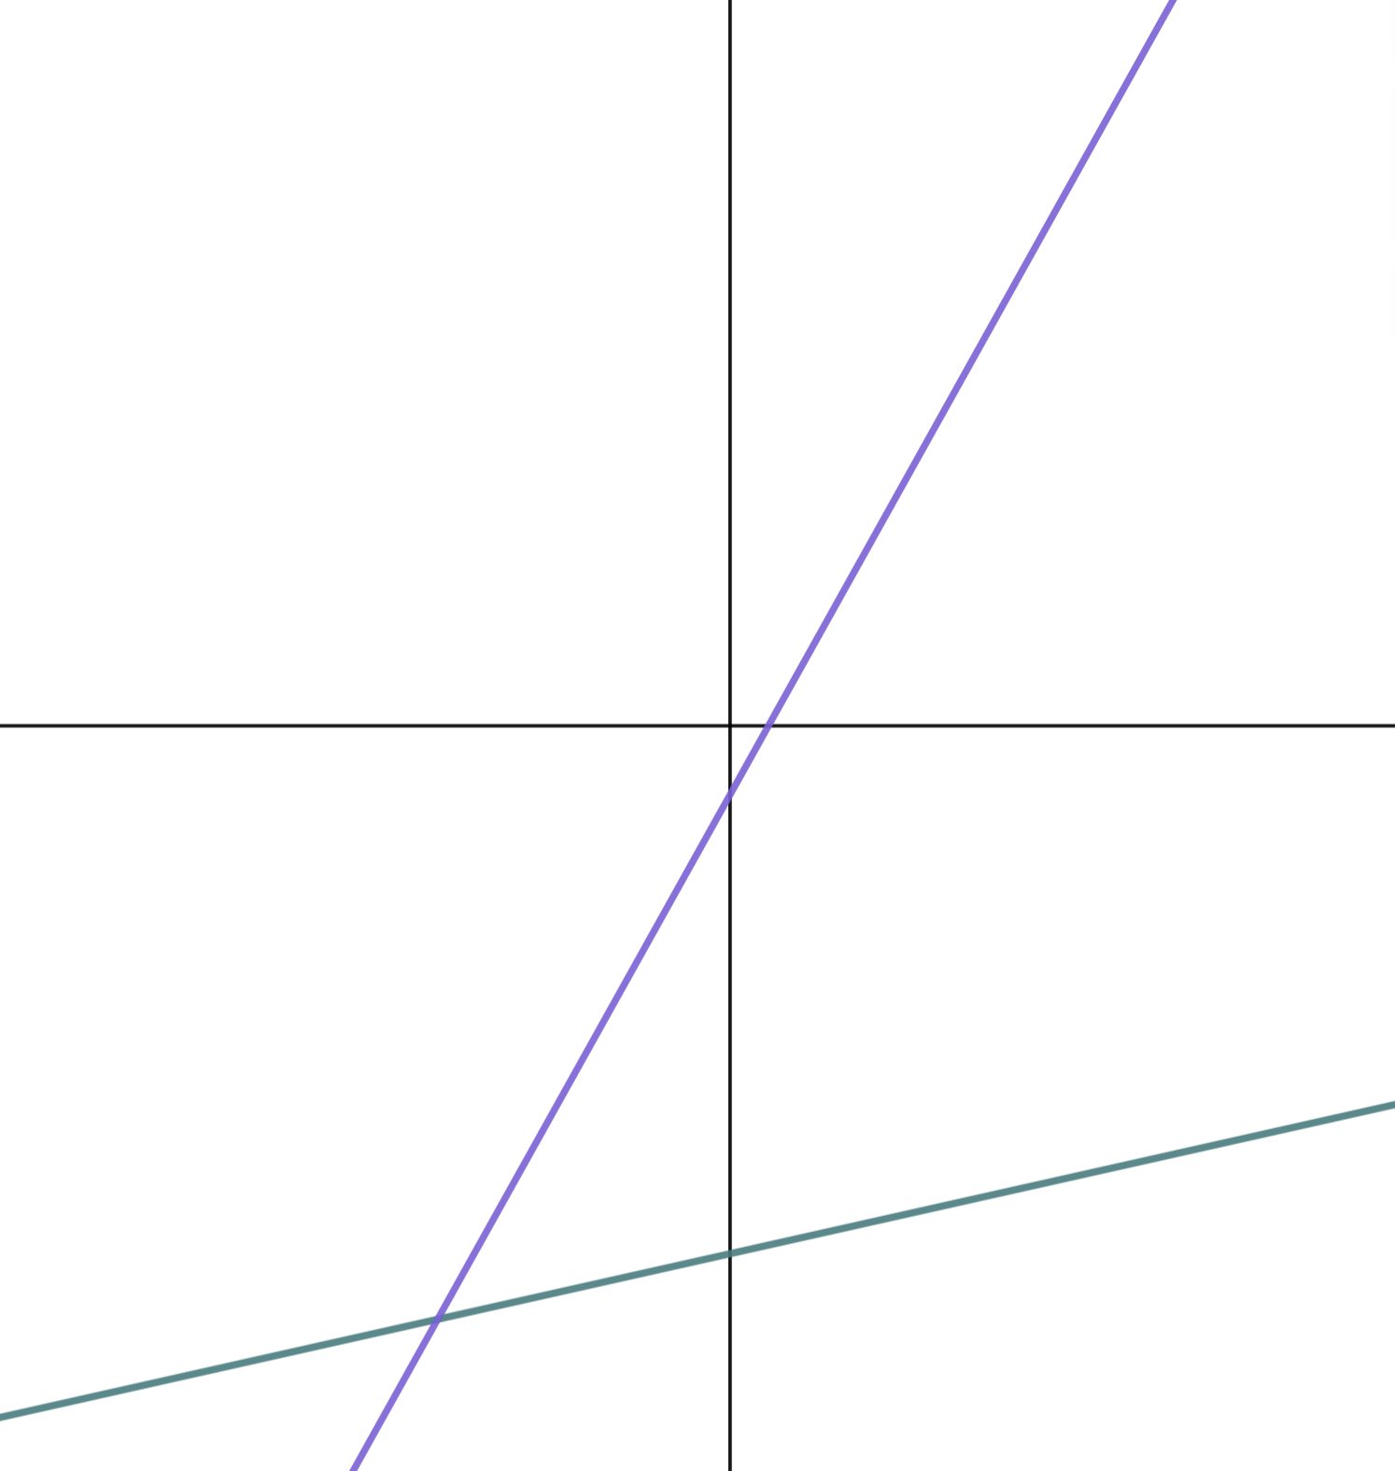
Equations and their graphs
Task B: Sketching linear graphs
1) Sketch the lines y = 2x + 10, y = 5 − 4x, and y = 2x − 5 on the below axes.
y-intercepts should be labelled and (0, 10) should be twice as far from the origin as (0, 5)
y
(0, 10)
✖
(0,−5) should be the same distance from the origin as (0, 5)
✖
(0, 5)
y = 2x + 10 and y = 2x − 5 should have the same gradient therefore look parallel in your sketch.
x
(0,−5)
✖
y = 5 − 4x is a steeper gradient. This should be visibly obvious.
2) Match the linear equations to their respective lines.
a)
b) y = 18 − 2x
c) y = −5x + 18
d)
y
y
a)
x
x
b) y = 18 − 2x
d)
c) y = −5x + 18
Mathematics in Education and Industry
v2.3

